Slide 1
SQL Security Principals 101
William Assaf,
He/Him,
Title,
Company

Slide 2
Explore PASS

Slide 4

William Assaf
Principal Consultant, Microsoft MVP, PASS Regional Mentor
He/Him
Title
Company
in/williamdassaf
@william_a_dba
SQLTact.com
Co-author, Microsoft Press, SQL Server Administration Inside Out 2017, 2019
Notes:
Information on me, I’ve spent the last 12 years as a consultant and most recently a principal consultant and leader a SQL Server consulting team, and only I the last few weeks have I accepted a position with Microosft on the SQL content development team.
Finally, throughout this presentation I may reference a script in a “toolbox”. Just for the low low price of attending this session, I’ve included a toolbox of SQL Server scripts to accompany this presentation. It’s available for download on the PASS Summit website accompanying this presentation.

Slide 5
Agenda
Logins, Users, and Authentication
Roles, “Ownership”, Schemas
Auth to Azure SQL DB
Useful permissions, scenarios
SQL Injection
Demo
Toolbox
Notes:
Today we’re going to cover a lot of important foundational material about security, accounts, authentication. For folks new to SQL Server security design and administration, this will be a great foundation for your learning. For those experienced in SQL admin, this will be a thorough evaluation of what you know, or thought you know, and maybe some gaps in what you know. I think there is content in here to interest everyone in the SQL career lifecycle, and I’m not just guessing at that. I got my first DBA job in 2006. I’ve been giving a presentation on Security at User Groups and SQLSaturdays basics for years, it was one of the first topics I started speaking technically on a decade ago. As my own experience has deepened and broadened throughout my career, so has the content I build into this presentation. So I’m going to start basic, and build quickly from there, focusing my content around common hurdles and tasks that database administrators face, in the hopes of deepening or broadening your experience, as well.
This is session one of a four part Learning Pathway on security. In subsequent presentations over the next three days,
John Morehouse is presenting part two, Understanding Modern Data Encryption Offerings for SQL Server, including a lot more information on all the various sorts of encryption, plus some important security features of SQL Server like Transparent Data Encryption and Always encrypted.
Jeff Renz is presenting on Securing Your Data In Azure: Tips and Tricks, which covers Advanced Threat Detection, the Azure Key Vault, cloud secure connection strings, and certified data sets for security in PowerBI.
Ed Leighton-Dick will cap it off with a presentation on Building a Security Dashboard for SQL Server, talking about when certs expire and what does that actually mean, more on Azure Advanced Threat Detection, SQL Audit and monitoring.
But today we’re setting the stage for a good conversation around security at PASS Virtual Summit 2020, especially around how permissions behave inside each database, how you can design database security, the relationships between logins, users, and databases. We’re start first by introducing the way security things are normal configured, but we’ll also discuss weird ways they veer from the normal.

Slide 6
Principal vs Principle
Principal
(noun) a person who is in charge of some responsibility
Example: The principal consultant talked to the school’s principal.
(adj) original, most important
Example: The principal aim of a good DBA is to defeat wicked developers.
Principle
(noun) a rule, guideline or fact
Example: Our guiding principles are based on science.
Notes:
So this is a common grammar issue in the English language, the difference between principal, P-A-L and principle, P-L-E.
Both can be a noun, but PAL describes a person, a person who could be your “pal”. A principle PLE is an inanimate thing, like guiding principles, or being principled, a way to describe someone who follows a moral or ethical code.
So today, we’re really talking about both today. Principals, PAL, are not only what SQL Server calls security objects in the database, Principles, PLE, that guide how we as DBA’s should design and create securables in our servers and database.

Slide 7
A Principal’s Principles
We can all be Principled Principals
who follow Principal Principles of security.
Notes:
My title at my last consultant company was Principal Consultant, so this Principal is going to share with you his Security Principals.
You’ll see Principals, PAL, in

Slide 8
Why is Security Important?
Proper implementation of SQL security principals:
Decreases administrative effort
Decreases application complexity
Decreases database surface area

Slide 9
Login vs User
Database User
Server Login
Has a database context
Often linked to a Login*
Does not have a password*
Stored in a Database
Included in DB Restore
Given access to SELECT, UPDATE, EXECUTE, CREATE TABLE, etc.
*Most of the time. We’ll talk about it.
Connects to a SQL Instance
Linked to AD (Windows Auth)
or has a password (SQL Auth)
Stored in the Master database, so not in other DB restores
Given access to CONNECT, VIEW SERVER STATE, CREATE DATABASE, etc.

Slide 10
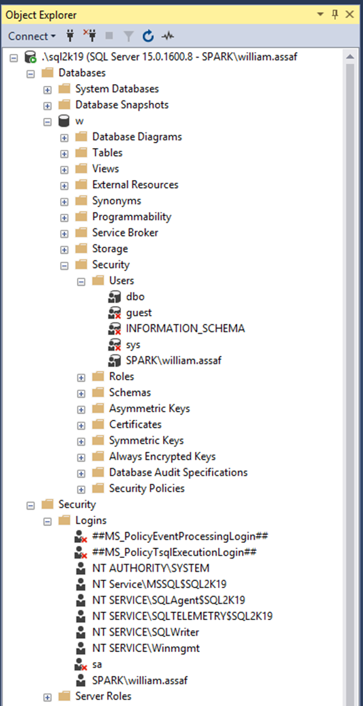
Login vs User
Database User
Server Login
Has a database context
Often linked to a Login*
Does not have a password*
Stored in a Database
Included in DB Restore
*Most of the time. We’ll talk about it.
Connects to a SQL Instance
Linked to AD (Windows Auth) or have a password (SQL Auth)
Stored in the Master database, so is not included in other DB restores
Notes:
Same info here, but we’re looking at object explorer in SQL Server Management Studio. …

Slide 11
AD Security Groups
Create logins for to AD Security Groups, not individuals. Insist on it.
Be aware of who is a member of those groups, and what groups are a member of groups, and what groups are a member of those groups…
Notes:
Devs -> App Support -> QA -> Financial Analysts…

Slide 12
AD Security Groups
You can interrogate AD for the members of security groups
EXEC master..xp_logininfo
@acctname = 'domain\groupname',
@option = 'members'
BUT it only returns FIRST level members, not recursive. Instead use PowerShell:
Get-ADGroupMember -identity 'Development' -recursive

Slide 13
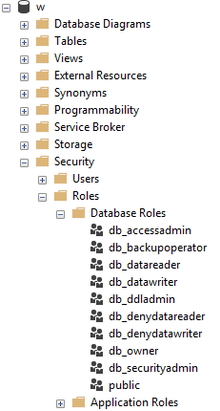
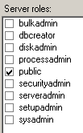
Server and Database Built-in Roles
Roles are security principals too
Logins added to Server Roles
Users added to Database Roles
Built-in Roles to provide a standard for access that may be too broad.
Follow principles of RBAC.
Notes:
<read slide first> RBAC is an acronym many in the governance area are familiar with, the idea that nobody gets permissions that are unique to them, they are only granted permissions based on their role, not their individual needs. Role Based Access Control means that creating specific permissions is a meaningful exercise, because it’ll be applied to members of a group. The last thing you want to end up with are many SQL Logins, each with their own permissions. This would make application maintenance and proper security auditing a nightmare. Instead, you should work with developers to identify permissions needed per role, and then create custom Server Role and/or Database roles to grant those permissions.
When granting permissions to a role, assign more specific permissions when possible. While you can add a role to the built-in database roles, like db_datareader or db_datawriter, that might be overreach. Your data within a database may not be homogenous in terms of sensitivity/permissions to access.
Later, we’ll talk about schemas, these are also security principals, and great way to grant more specific permissions than to all objects in a database.
Last on these sample images here, you’ll notice the public roles at both the server and database level, and how that server role public checkbox is always checked. And it can’t be unchecked. Let’s talk about public.

Slide 14
Public
Every login/user is a member of “public” roles.
All logins/users inherit permissions granted to public.
Public is a server role that should never be granted any additional permissions, authorization or ownership.
Public is also a database role. Every database user/role belongs to a public database role.
Notes:
<read notes instead>
Every login is a member of the public server role. Every user in each database is a member of the that database’s public database role.
Only very lazy and short-sighted developers would grant permissions to public, which allows every user that does or ever will exist, to inherit permissions.
Permissions assigned to the public role is a clear sign of lazy developers. Don’t be a lazy developer.

Slide 15
Public
Should fail any app security audit or DB audit. Trust me.
Expected non-issue findings from Database Diagram feature.
A pain to unravel.
Check for this.
Toolbox: 1 - public permissions.sql
Notes:
<read slide first>The strategy to undo a security architecture based around public can be complicated, involves lots of testing, almost certainly requires participation from the developers to figure out what permissions are actually needed.

Slide 16
Guest
Special built-in user in each database.
Any login that doesn’t have a mapped user in a database inherits GUEST.
By default, this is disabled in all databases.
Check for this.
Toolbox: 2 - guest permissions.sql
Notes:
<read slide first>
For what should be very obvious reasons, never grant any permissions, even CONNECT, to GUEST, unless you understand what you’re doing.
If a login doesn’t have a user in a database, it shouldn’t have access to the database.
Not a secure solution for future access. Similarly, this could also trip a SQL Server security audit failure.

Slide 17
Server Logins
Logins are given a default database.
CONNECT will fail if the Default Database is not accessible.
Best practice: set Default Database to the intended User Database, or to TempDB, which is always there, but not persistent.
Notes:
<read notes first>
Again, a SQL Server Login is a server-level security principal
A User is a database-level principal
<click>

Slide 18
Server Logins + Database Users
A Server Login is what authenticates a connection to SQL.
A Database User provides a Login with database access.
Notes:
<read slide first>
“Login” is a server level security principal.
“User” is a database level security principal.
Now, let’s talk about the different types of SQL Server Logins, they’re differentiated by how they authenticated to SQL Server.

Slide 19
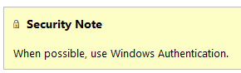
SQL Authenticated Logins
SQL Logins are authenticated by a SQL Server instance.
“Enforce Password Policy” encouraged, but not required!?
More administrative effort to maintain, migrate, secure.
Notes:
1. We’ll talk more about this but this means each SQL Server is now an authority for its own credentials. If you have 10 SQL Server instances, that 10 different sets of logins and passwords to maintain, as opposed to one Active Directory.
2. Strongly encouraged to Enforce password policy, which can include password expiration, inheriting from the same settings in Windows.
Unfortunately, the password policy is optional! Password could be password, empty string, or the same as the user name.
Also, if a login doesn’t currently have the password policy enforced, you can check the box, but it doesn’t apply to the current password. So it’s way too easy to mark a login to apply policy, but have a password that is NOT strong enough to meet policy. The policy would only then be checked if it is changed.
3. Multiple failed SQL auth login attempts will Lock Out, which a DBA must resolve. Because these credentials are specific to each instance, it also means that SQL logins must be kept synchronized, more or less manually, between replicas in an Availability group
Finally, see here a plain and clear screenshot from Microsoft Docs. Use Windows Auth when possible. Don’t even enable SQL Auth unless you have to – it’s not enabled by default when you go to install SQL Server. You have to go out of your way to configure the instance in Mixed Mode, which enables SQL Logins and allows the built-in “sa” account to be enabled.

Slide 20
SQL Auth Passwords
Check for weak or easily predicted passwords.
Compare hash results to sys.sql_logins.password_hash.
Toolbox – 3 easy passwords.sql
Notes:
<read notes> Let’s talk more about the optional password policy in SQL Server.
If you’re a sysadmin, you can perform what is essentially a rainbow attack against your own SQL Server to look for weak or easily predicted passwords. You can do this because SQL Server makes the one-way password hash function available to you. So you can run any string through the hashing function, then, compare the one-way hash to what SQL Server stores. So while you can’t reverse engineer or decrypt a password, you can generate a hash of any string, then compare hashes. And you can do all of this without failing a login attempt or locking out a login.

Slide 21
Windows Auth vs SQL Auth
In a typical enterprise business environment,
Windows Authentication means that:
account creation/termination,
security group membership,
password policy,
are all handled by an existing corporate security administration infrastructure.
Notes:
<read notes first>
So we’ve talked about how SQL auth really creates additional administrative overhead and the fragmentation of security for user and even application access. In comparison to Windows Authentication, specifically using Active Directory, SQL Authentication creates a decentralized security setup in each instance.
<click, read slide>
Centralizing account and password management, role assignment, these are good things to do from a governance standpoint and from the standpoint of, that thing you see on Certification Exams all the time? “Least amount of administrative effort”
Proper use of the Windows Authentication model creates Server Logins that are linked to Domain Accounts, Preferably linked to Security Groups in Active directory, not individuals, so that membership is also managed by your existing security infrastructure.
Windows Authenticated Logins can also be created for Local Windows users, local to the Windows Server. This isn’t ideal, creating some of the decentralization and redundancy issues common for SQL Authenticated logins. Don’t recommend them except for potential use in SQL Servers outside of a domain.
In any case, SQL Server inherits the password policy of the local Machine Policy, regardless of whether or not the local Machine Policy is inherited from a Domain Policy.

Slide 22
Windows Auth and Apps
Using Windows Auth requires the OS to authenticate.
In Windows, this is the SSPI, which will authenticate via Kerberos or NTLM. This is non-trivial.
Kerberos requires Service Principal Name (SPN).
NTLM = old MS Authentication protocol that Kerberos replaced.
If you get SSPI issues, it’s likely a double-hop or trust issue.
Use Service Accounts in all cases, SQL or Windows Auth.
Notes:
Now, to be fair, Windows Authentication does have a complexity increase.
<click>
<read slide bullet points 1-5>
<read notes>
You may have encountered this before if trying to use Windows Authentication from an Internet-facing server, like an App Server in a DMZ, or otherwise outside of the domain. Kerberos may be required to authenticate a Windows User directly from the application server to the SQL Server. Can increase the complexity of an application loadout, but this is the Enterprise approach. I don’t have time to do a deep dive on this today, but this is fairly well documented and may involve your Active Directory admins helping to configure.
<click>
This is why I still see SQL Authentication used by many applications, because developers don’t want to have to ship applications that depend on this kind of trust. To be clear, this is less secure.
The best way to design this is that applications that SQL Logins at least use a SQL Login that isn’t used interactively.
When I say interactively, I meant that no human is ever typing in this user name and password. Make the password painfully long, even.
Make sure that developers themselves don’t use the SQL Login, they should still use their own Windows Authentication, even if they are external vendors. A defining characteristic of a Service Account is that nobody knows its password, and at least, it isn’t used interactively.
We’ll talk about service accounts more later on, and especially the different options around Windows Authenticated Service Accounts.

Slide 23
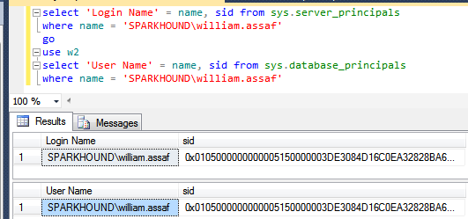
Logins + Users
A User can be linked to any Server Login
The names don’t actually have to match, but they should.
A SID (Security-IDentifier) is shared by User and Login.
Notes:
In Windows Authentication, that SID comes from the Windows provider, likely Active Directory. So in all SQL Servers where that domain account is used, it’s got the same SID.

Slide 24
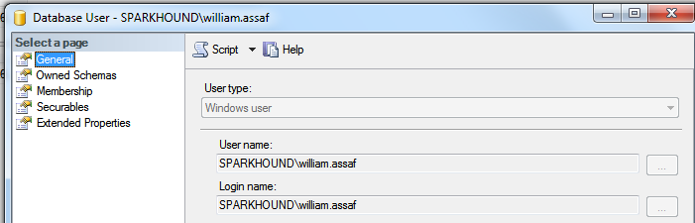
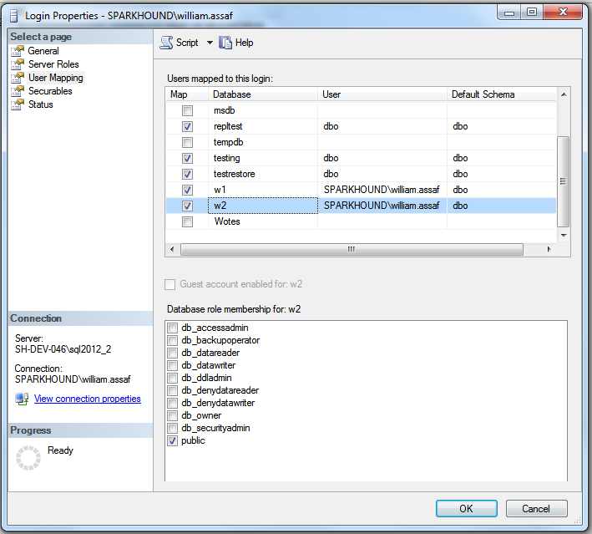
Login Mapping to Database User
Logins are mapped to Users in the User Mapping page of the Login properties dialog.
Notes:
It’s here in the mapping that users take on the SID of the login.
Note here also the user “dbo”, this is a special user in each database that sysadmins can use. We’ll talk more about dbo and its shifting uses over the years later on.

Slide 25
Orphaned SID
DB Users can be disconnected from their SQL Auth Login.
Commonly occurs when a database is restored from one SQL instance to another.
Only with SQL Auth Logins, not Windows Auth Logins.
SQL Auth Login = local SID, Windows Auth Login = AD SID
Notes:
<read slide>
Now, why is that? Why would this only affect SQL Authenticated Logins?
<click>
It’s because, unless you specify a SID yourself, the SID for a SQL Server is generated locally at each SQL instance. IF you got and create a Login named test on 5 different SQL server instances, you’ll get a Login named Test with five different SIDs. There is a way to create a SQL Auth Login with a pre-determined SID, this is how migrations happen, we’ll talk about this in a bit.
If you create a Windows Login for the same Active Directory account on five SQL instances, each Login has the same SID, because all five SQL instances got the SID from the same place, AD. Therefore any user associated with the Login will have the same SID, on any SQL instance. This is becomes incredibly important for Availability Groups, where is much simpler to distribute an Windows Login from AD to each replica, versus distributing a SQL Server authenticated login to each replica, scripting it out to use the same SID in each instance.

Slide 26
Fix Orphaned SID
To re-associate a database user to a server login:
ALTER USER username WITH LOGIN = loginname;
SELECT DBUser_Name = dp.name
, Login_Name = sp.name
FROM sys.database_principals AS dp
INNER JOIN sys.server_principals AS sp
ON dp.name = sp.name
WHERE sp.sid <> dp.sid
Toolbox: 4 – fix orphaned sid.sql
Notes:
Let’s say the login already exists, with two different SIDs, and we need to go ahead and repair the user, to link it back with its Login. The command is actually quite simple. You can also proactively identify orphaned logins by comparing their names and SID in SQL Server’s internal metadata.
<click>
Here’s the basic join, and there’s a script in this session’s toolbox that helps you quickly identify and repair orphaned SIDs. If you’re an experienced DBA, remembering to look for and fix orphaned SIDs is a necessary followup any time a database is restored from one server to another, for example, to update a dev or test environment from production.

Slide 27
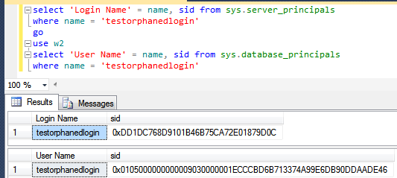
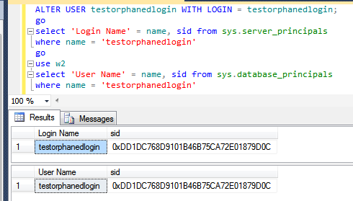
Fix Orphaned SID
Notes:
You’ll know you have a problem with an orphaned SID if the end user or application gets an error like this. “The server principal is not able to access the database under the current security context“, this is a symptom of a mismatched SID.
<click>
And here, we can verify in the system views that indeed, I’ve got a SQL authenticated login and a Database User of the same name, but different SIDs.
<click>
After running ALTER USER with LOGIN, you can see now that the Database User has been modified to reflect the SID of the login on this SQL instance.

Slide 28
SQL Auth Login Migration
Not possible to reverse-engineer a SQL Auth Login password.
Migration of SQL Logins is accomplished by:
Backup+restore of the master database (complicated) -OR-
Creating SQL Logins with same SID but new password (not desirable) -OR-
Generating a hash of the password and same SID (most desirable) Let’s go more into that….
Notes:
<read notes>Like we said earlier it is not possible to reverse-engineer a SQL Auth Login’s password, you can guess it an infinite number of times via the hashing algorithm we discussed earlier, but you can’t see it.
So when migrating SQL Logins from one instance to another during an upgrade or migration, you have options.
<click>
The first option involves restoring the master database, which is obviously only possible in a migration to the exact same SQL Server version. You may also find this more or less impossible if the drive letters are changing, so consider restoring the master database an important disaster recovery option in the event of a baremetal restore, but not an option for server upgrades.
<click>
Scripting out all SQL Logins with the same SID but a new password is possible, but breaks a lot of connection strings, and it’s unnecessary because,
<click>
We can generate that hash of the password, without knowing the password, and using that and the SID, can recreate a login on the other instance. This is easily scriptable. Let’s talk more about that.

Slide 29
SQL Auth Login Migration
Microsoft has provided a pair of sprocs to generate the hash of passwords: support.microsoft.com/kb/918992
sp_hexadecimal + sp_help_revlogin
But don’t forget to migrate the server-level permissions:
Toolbox: security Script servers.sql

Slide 30
SQL Auth Login Migration
Microsoft has provided a pair of sprocs to generate the hash of passwords: support.microsoft.com/kb/918992
sp_hexadecimal + sp_help_revlogin
Create both in master then EXEC sp_help_revlogin
But don’t forget to migrate the server-level permissions:
Toolbox: security Script servers.sql

Slide 31
Sql login SIDS
Creation of the SQL Login with its existing password AND SID is critical.
This is also important for setting up new Availability Groups, as the Login SIDs must match on every replica.
A regular proactive check for all SQL Server instances in Availability Groups:
Check that all SQL Logins exist
AND they have the same SID, not just same NAME

Slide 32
Contained databases
Not very common architecture but notable.
Moves authentication from the Server level directly to the Database level.
A contained database owner, for example an Application owner, has full control over security in the database.
No server-level (or sysadmin) permissions necessary
Contained database has no configuration dependencies on the instance, it can be easily moved to another instance.

Slide 33
Contained databases
In SQL Server, Authentication can be made with Windows Auth logins or Contained Database Users where the password is maintained inside the database.
Agent jobs, system error messages, linked server information, and system settings are all inside the contained database instead of master or msdb.

Slide 34
Contained databases
What this means is that this syntax, which heretofore made no sense, on a contained database is perfectly valid:
USE [SomeUserDatabase];
CREATE USER BI_User WITH PASSWORD ='strongpassword';

Slide 35
Contained databases
A database platform where all the major necessities for authentication and system objects are stored in the user database…
No system databases needed, so the database is easily portable between servers…
What does this sound like?
Azure SQL Database!

Slide 36
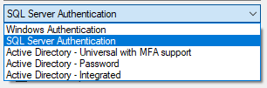
Azure SQL DB
Additional types of authentication since SSMS 2016
“Active Directory” options used for Azure AD only

Slide 37
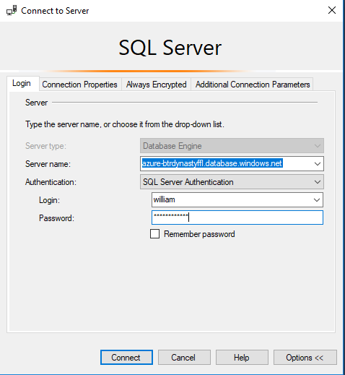
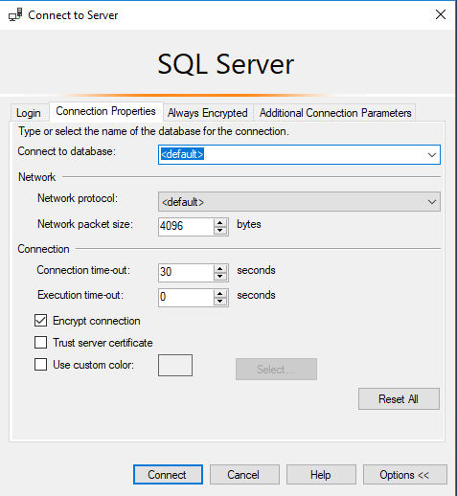
Azure SQL DB
Only real caveat when connecting to an Azure SQL DB: You youths can’t use USE, you must set the context at login.

Slide 38
Azure SQL DB
You can use Azure Active Directory accounts only for Azure SQL contained database users, but not for Azure SQL server logins. Example: in [SomeUserDatabase]
CREATE USER [reportuser@domainname.onmicrosoft.com] FROM EXTERNAL PROVIDER;
Only Active Directory accounts can create other Active Directory accounts in Azure SQL Database. You add the first via the Azure Portal.

Slide 39
Azure SQL DB
Otherwise, most (not all) permissions, objects, schema operate the same on Azure SQL Database, Azure SQL Managed Instance (MI), SQL Server, and SQL Server on Linux.
In this presentation when we’re talking about permissions, stored procs, views, functions, it’s the same for any platform.

Slide 40
A BIT ON Connection providers
OLEDB was un-deprecated, re-released in ‘18. https://blogs.msdn.microsoft.com/sqlnativeclient/2017/10/06/announcing-the-new-release-of-ole-db-driver-for-sql-server/
Install and Convert your OLEDB connection strings from sqlncli11 or sqloledb, to the new MSOLEDBSQL.
There is also a relatively new ODBC Driver 17 for SQL Server. https://techcommunity.microsoft.com/t5/SQL-Server/ODBC-Driver-17-for-SQL-Server-Released/ba-p/385825
Both replace the OLEDB/ODBC functionality of the SQL Native Client (SNAC) which is no longer maintained.
New OLEDB or ODBC can connect to SQL on-prem and Azure
Important to update sqlncli10 for Availability Groups
https://www.sqltact.com/2019/06/actual-emails-will-msoledb-work-for.html

Slide 41
Basic user permissions
DML*
SELECT
DELETE
UPDATE
INSERT
REFERENCES
*Data Manipulation Language
DDL**
ALTER
CONTROL
VIEW DEFINITION
CREATE
DROP
EXECUTE **Data Definition Language
Modify Security
GRANT
REVOKE
DENY
IMPERSONATE

Slide 42
USEFUL permissions
Commonly requested permissions for non-sysadmins
ALTER TRACE For SQL Profiler and traces
ALTER ANY EVENT SESSION For XEvents (better than traces!)
VIEW SERVER STATE For server-level DMV’s, XEvents
VIEW DATABASE STATE For database-level DMV’s
VIEW ANY DEFINITION For definitions of objects
These permissions are given by the GRANT syntax GRANT VIEW SERVER STATE TO [SPARKHOUND\william.assaf];
_____________________________________________________
GRANT VIEW SERVER STATE TO [SPARKHOUND\DBATeam];

Slide 43
Basic user permissions SAMPLE SCENARIO
GRANT SELECT ON game.PingPongScores TO [PINGPONG\FGump];
GRANT EXECUTE ON game.spGetScore TO [PINGPONG\FGump];
GRANT EXECUTE TO [PINGPONG\FGump]; --in current db context
GRANT VIEW DEFINITION ON game.spGetScore TO [PINGPONG\FGump];
GRANT ALTER ANY EVENT SESSION TO [PINGPONG\FGump];
GRANT VIEW SERVER STATE TO [PINGPONG\FGump];

Slide 44
More USEFUL permissions
SHOWPLAN Viewing execution plan for executable query
IMPERSONATE Allows testing as another user
CONNECT ALL DATABASES Allows the login to set any database context (USE) but grants no other rights in each database, potentially appropriate for day-to-day accounts
SELECT ALL USER SECURABLES SELECT from all objects in ALL db’s, potentially appropriate for day-to-day accounts

Slide 45
GOTTA KEEP EM SEPARATED
All Administrators (including DBA’s) should have two accounts: one for day-to-day workstation/email access, one for production admin-level access.
Day-to-day accounts may have read-only access to non-sensitive databases, including system metadata, job status, logs, etc.
The same domain accounts that have production access should not have VPN/remote access.

Slide 46
CONTROL permissions
CONTROL SERVER Effective the same as sysadmin. Not for non-admins.*
CONTROL DATABASE Effective the same as db_owner. Not for non-admins.*
*One minor difference. CONTROL permissions can be affected by DENY, but sysadmin/db_owner cannot.
Let’s demonstrate…

Slide 47
Testing Permissions with EXECUTE AS
USE [master];
CREATE LOGIN [domain\username] FROM WINDOWS;
GO
GRANT CONTROL SERVER TO [domain\username];
DENY VIEW SERVER STATE TO [domain\username];
GO
EXECUTE AS LOGIN = 'domain\username';
SELECT * FROM sys.dm_exec_cached_plans; --Fails
GO
REVERT; --Reverts the EXECUTE AS
GO
Notes:
While the sysadmin role is unaffected by any DENY permissions while the CONTROL SERVER permission is. CONTROL SERVER is needed to access sys.dm_exec_cached_plans, a server-level DMV for reviewing plans in cache.

Slide 48
Testing Permissions with EXECUTE AS
EXECUTE AS makes it possible for you to simulate the permissions of another principal in your current session.
Always follow an EXECUTE AS with a REVERT, which stops impersonation. A REVERT affects only one EXECUTE AS.
During testing, display what principal you are:
SELECT ORIGINAL_LOGIN(), CURRENT_USER;
ORIGINAL_LOGIN() The name of the login with which you actually connected. This will not change even after you use EXECUTE AS USER or EXECUTE AS LOGIN.
CURRENT_USER. The name of the user you have assumed.

Slide 49

SQL INJECTION
https://xkcd.com/327/

Slide 50
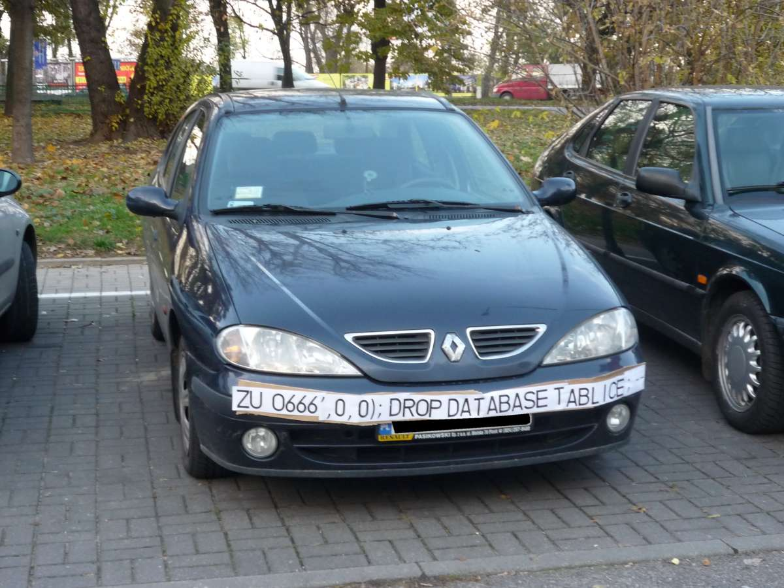
SQL INJECTION

Slide 51
SQL Injection
This is a much larger topic with lots of info out there.
SQL Server is better than some RDBMS platforms but is not immune to SQL Injection attacks made possible by security-ignorant development.
Developers must be aware of SQL Injection-blocking patterns on public websites:
Parameterize the input from the website (use sprocs!)
Sanitize inputs of special characters
Don’t run websites logins with more databases permission than needed (again, use sprocs!)

Slide 52
what can you do to prevent SQL Injection?
Design tables with appropriate data types and lengths.
Insist on stored procedures for public-facing operations like searches. Be aware of what db’s have public apps.
Insist on stored procedures for Entity Framework (or other ORMs) operations involving 2+ entities.

Slide 53
what can you do to prevent SQL Injection?
Avoid apps running with permissions like the db_datareader and db_datawriter roles, and certainly not db_owner.
Avoid the use of EXECUTE AS in code, which could allow injected code to execute with elevated security.
Train devs on patterns of stored procedure parameter sanitizing. Never use EXEC() or sp_executesql with user-enterable data.

Slide 54
what can you do to prevent SQL Injection?
Provide links, attention, and visibility to PM’s and Dev’s for SQL Injection awareness.
Lobby for penetration testing and SQL Injection detection tasks in sprints.
With Azure SQL DB, enable Azure Threat Detection!

Slide 55
AZURE threat detection
Azure SQL Database Threat Detection is a security intelligence feature built into the Azure SQL Database, activated with a button click.
Detects potential vulnerabilities such as Potential SQL Injection attacks, brute force attacks, anomalous login patterns, and more.

Slide 56
Feature Restrictions
Azure SQL Database and SQL Server 2019 have a pair of minor anti-injection feature to disable a pair of common probing attacks.
An injection attack will use delay or error messages to probe for vulnerabilities. An Error Message could contain object names.
You can disable WAITFOR and all error messages for a database user or role. For example:
EXEC sp_add_feature_restriction N'ErrorMessages', N'User', N’WebUser’
EXEC sp_add_feature_restriction N’WaitFor', N'User', N’WebUser’
Bypassed if running your website as a sysadmin or db_owner!
Learn more: https://docs.microsoft.com/en-us/azure/sql-database/sql-database-feature-restrictions

Slide 57
SSMS Vulnerability Assessment
Built into SSMS, there is a Vulnerability Assessment tool available via Object Explorer in each Database -> Tasks.
Introduced in SSMS 17.4 in SQL 2017.
Many findings have to do with database-level permissions that we’re discussing today: PUBLIC, GUEST, user-defined roles, low-impact roles, orphaned roles, least privilege, and more.

Slide 58
Stored procedures
Stored procedures require EXECUTE to run, and do not require all underlying object permissions (SELECT, INSERT, DELETE)…
…provided that the sproc doesn’t perform IDENTITY_INSERT on a table, which requires ALTER permissions not abstracted.
…provided that all the underlying objects have the same ownership chain.
…provided that the stored procedures do not use dynamic sql commands exec sp_executesql @SQL or EXEC(@SQL)

Slide 59
Stored procedures
Given those conditions, thanks to the database permission chain, you can:
GRANT EXEC rights to sprocs that INSERT UPDATE and SELECT from a table.
GRANT no other permissions to the table!
The user can read data in the table using the sproc ONLY.

Slide 60
Stored procedures
Consider DENYing SELECT rights to the public role, which is inherited by all user roles aside from db_owner and sysadmin.
Users prevented from accessing any tables or views directly from any application (SSMS, Access, Excel!).
User access to data is forced through sprocs. (Good!)

Slide 61
Views
Similar to stored procedures, a VIEW will allow a user to SELECT data from tables to which the user does not have access. (This is helpful!)

Slide 62
User-Defined Functions (UDF)
Similar to stored procedures, a UDF will allow a user to SELECT data from tables that the user does not have access to.
Keep in mind the performance impact of functions can be severe, especially in the SELECT portion of a query.
Overuse of UDF’s are common causes for performance issues. High potential for cursor-like effects.

Slide 63
laB
Demonstrate how Stored Procedures, Views, and Functions abstract the permissions necessary to view underlying table data.
Toolbox\Security p1.sql – logged in as sysadmin
Toolbox\Security p2.sql – logged in as testing user

Slide 64
Builtin\administratorS
Prior to SQL 2008, [BUILTIN\Administrators] was a member of the SQL sysadmin role.
This was a security hole – allowing anyone who gained admin access to a Windows Server to automatically and easily have sysadmin access.
SQL 2008 – BUILTIN\Administrators no longer have automatic rights to the SQL server and should NOT be granted access.

Slide 65
dbo
In SQL 2000, sales.dbo.customers meant:
databasename = sales
owner = dbo
tablename = customers
In 2005 and later, sales.dbo.customers meant:
databasename = sales
schema = dbo
tablename = customers

Slide 66
dbo
In SQL 2000, dbo was a special user inside each database with sysadmin permissions, which by default owned any object created by an admin.
In SQL 2005 and above, dbo is the default schema and no longer a security object. Saying a user has “dbo permissions” is incorrect.
[db_owner] is just a user role with no server-level permissions.

Slide 67
ownership
Microsoft has done away with the terminology of Users or Logins “owning” objects, such as databases and schemas.
Changing the AUTHORIZATION is now the more accurate term to describe “ownership” of an object.
For example, sp_changedbowner is deprecated, replaced by ALTER AUTHORIZATION

Slide 68
Schemas
A schema is a securable container
It contains database of objects, by default objects are inside the internal “dbo” schema.
Additional user schemas can be created. Permissions can be granted to schemas as a set.
Examples:
logical [Staging], [ODS], [Audit], [WH]
business [Sales], [HR], [Acct], [Inv]

Slide 69
Cross database ownership
A sproc/view can return data from a table in another database without permissions, if the two databases share the same owner login, by enabling Cross-Database Ownership Chaining on both databases.
This is not enabled by default on user databases. It has to be enabled at the server level then activated in each database…

Slide 70
Cross database ownership
Any login can take advantage of Cross-Database Ownership Chaining from another database.
Stored procedures and views – not queries - can then query other databases without any additional permissions.
Which could be very helpful, or a security risk…

Slide 71
Cross database ownership
It is possible that cross-database ownership can bypass your permissions by querying from the context of another database!
Enabling Cross-Database Ownership Chaining increases the necessary complexity of securing your data with minimum permissions.
You probably don’t need it, do it right.

Slide 72
Application roles
By executing sp_setapprole, a user connection inherits the permissions of an app role.
The application role has no permanent members, but is assigned permissions and given an app-only password.
The user connection assumes only the permissions of the application role.
You can utilize Active Directory-based Windows authentication without giving direct permissions.
Can be part of a strategy to force use of database to occur only via the application.

Slide 73
Application roles
Cons:
Accessing other databases requires the use of the guest role.
Connection pooling can be problematic (cookies)

Slide 74
Continued reading
http://msdn.microsoft.com/en-us/library/ms191291.aspx
https://docs.microsoft.com/en-us/sql/connect/oledb/oledb-driver-for-sql-server?view=sql-server-2017
https://blogs.msdn.microsoft.com/sqlnativeclient/2017/10/06/announcing-the-new-release-of-ole-db-driver-for-sql-server/
https://techcommunity.microsoft.com/t5/SQL-Server/ODBC-Driver-17-for-SQL-Server-Released/ba-p/385825
http://social.technet.microsoft.com/wiki/cfs-file.ashx/__key/communityserver-wikis-components-files/00-00-00-00-05/5710.Permissions_5F00_Poster_5F00_2008_5F00_R2_5F00_Wiki.pdf
http://msdn.microsoft.com/en-us/library/bb669058(v=VS.110).aspx
http://blogs.msdn.com/b/sqlsecurity/archive/2011/08/25/database-engine-permission-basics.aspx
http://msdn.microsoft.com/en-us/library/ms191465.aspx
https://docs.microsoft.com/en-us/sql/relational-databases/databases/security-best-practices-with-contained-databases?view=sql-server-2017
https://azure.microsoft.com/en-us/blog/azure-sql-database-threat-detection-your-built-in-security-expert/
https://www.slideshare.net/GrantFritchey/sql-injection-what-it-is-how-to-stop-it
http://technet.microsoft.com/en-us/library/ms187359.aspx
http://support.microsoft.com/kb/918992
https://azure.microsoft.com/en-us/documentation/articles/sql-database-aad-authentication/
https://azure.microsoft.com/en-us/documentation/articles/sql-database-manage-logins/

Slide 75

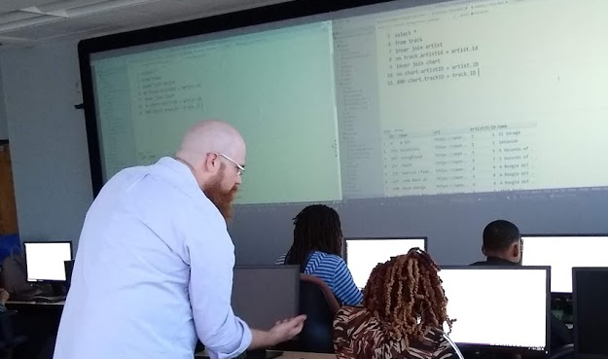
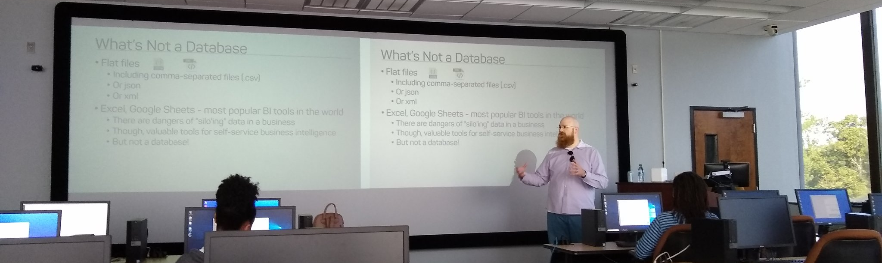
Support your Local STEM Initiatives
I encourage you to find, then donate time and money to local STEM education initiatives where you live. Get involved!
There is almost certainly some nonprofit where you live that needs your enthusiasm and skills to close the achievement gap.
https://www.thewallsproject.org/programs/futures_fund/

Slide 76
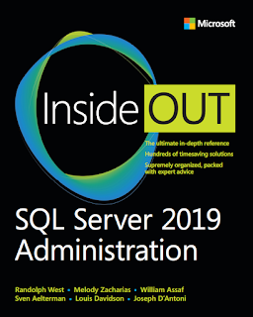
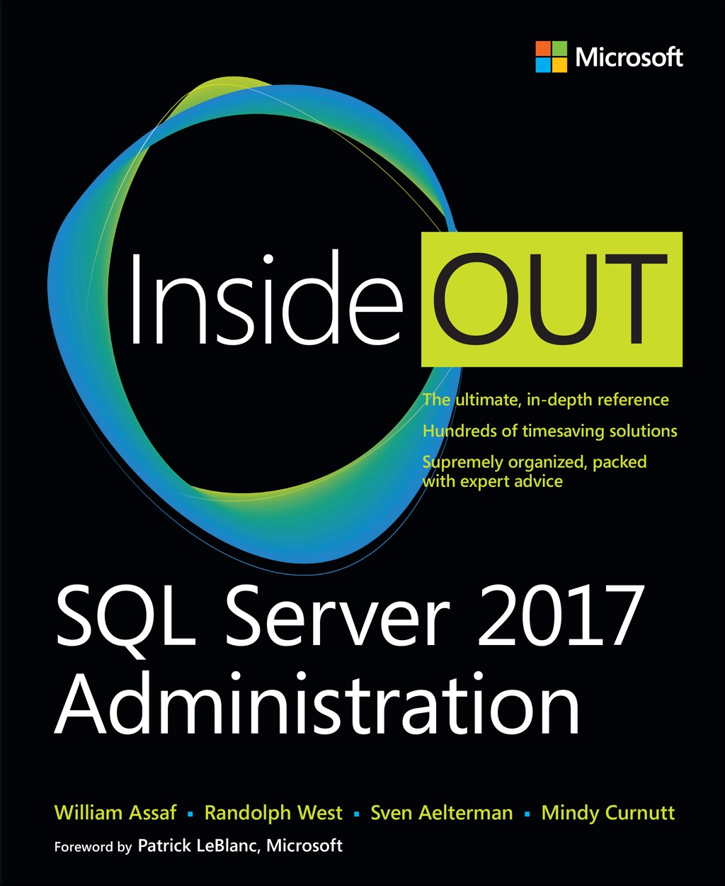
SQL Server 2017 Inside Out
SQL Server 2019 Administration Inside Out
by Microsoft Press
2017 published Feb 2018
2019 coming March 2020

Slide 77

Bio and contact
William D Assaf, MCSE
Baton Rouge SQL Server UG board
Principal Consultant, SQL Manager at Sparkhound
William.Assaf@sparkhound.com
Twitter: @william_a_dba
This presentation, including all source code, available at my blog:
SQLTact.com

Slide 78
UpCOMING EVENTS
Baton Rouge .NET UG
brdnug.org
Every 2nd Wednesday
Baton Rouge SQL Server UG
brssug.org
Baton Rouge Analytics and Intelligence Network
gobrain.org
Baton Rouge SQLSaturday
At LSU
March 7 – BI
August 1 – Everything
SQLSaturday.com
Activate Conference
At LSU
September 19 2020
ActivateConf.com

